Slide 1
Investigation of the Feasibility of Individual Identification Based on Pupil Diameter Changes Caused by Visual Stimuli

Slide 2
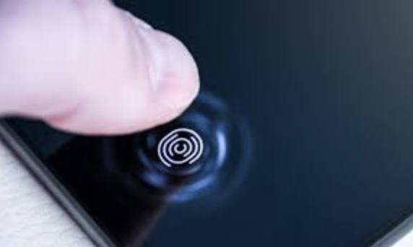
Introduction
2
Background
Increasing need for securing personal information when using VR devices
Existing Methods
Finger point recognition
Event-related pupillary response
Research Gap
An approach that doesn’t rely on personal biometric information
Notes:
Start with background intro
Several existing … finger point and facial recognition are …
… could also be used in building …
However, these methods use biometric information as underlying feature
Risk of biometric information leakage
Motivation of our study

Slide 3
Proposal
3
Physiological Facts
Pupil size dilates and constricts in responses to visual stimuli.
Visual stimuli involve light intensity and color changes.
Proposal
Is there any specific light stimulus or color change that elicits pupil size changes could be utilized for personal authentication?
Notes:
It is true that…
…visual stimuli involve light intensity
Based on this physiological fact, we assumed that … elicit individual pupil size feature
Our proposal for this study is to figure out … that has the best performance on eliciting pupil size feature

Slide 4
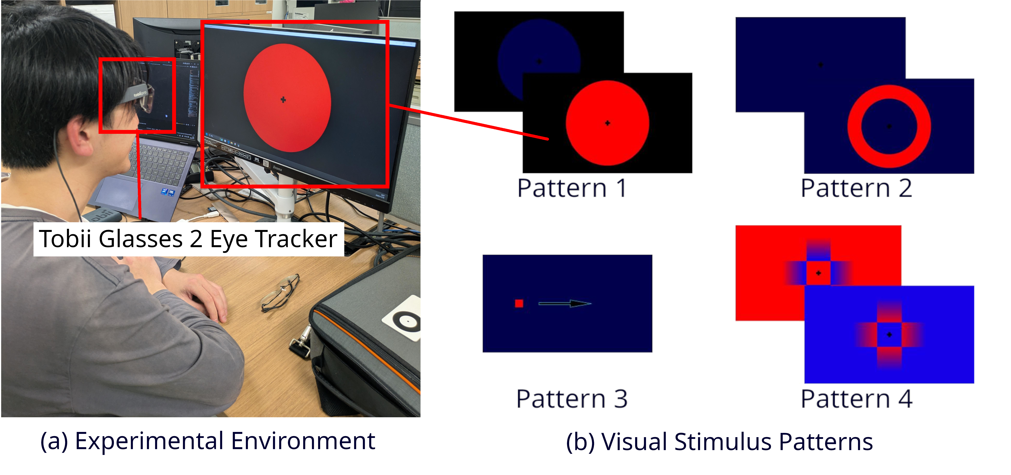
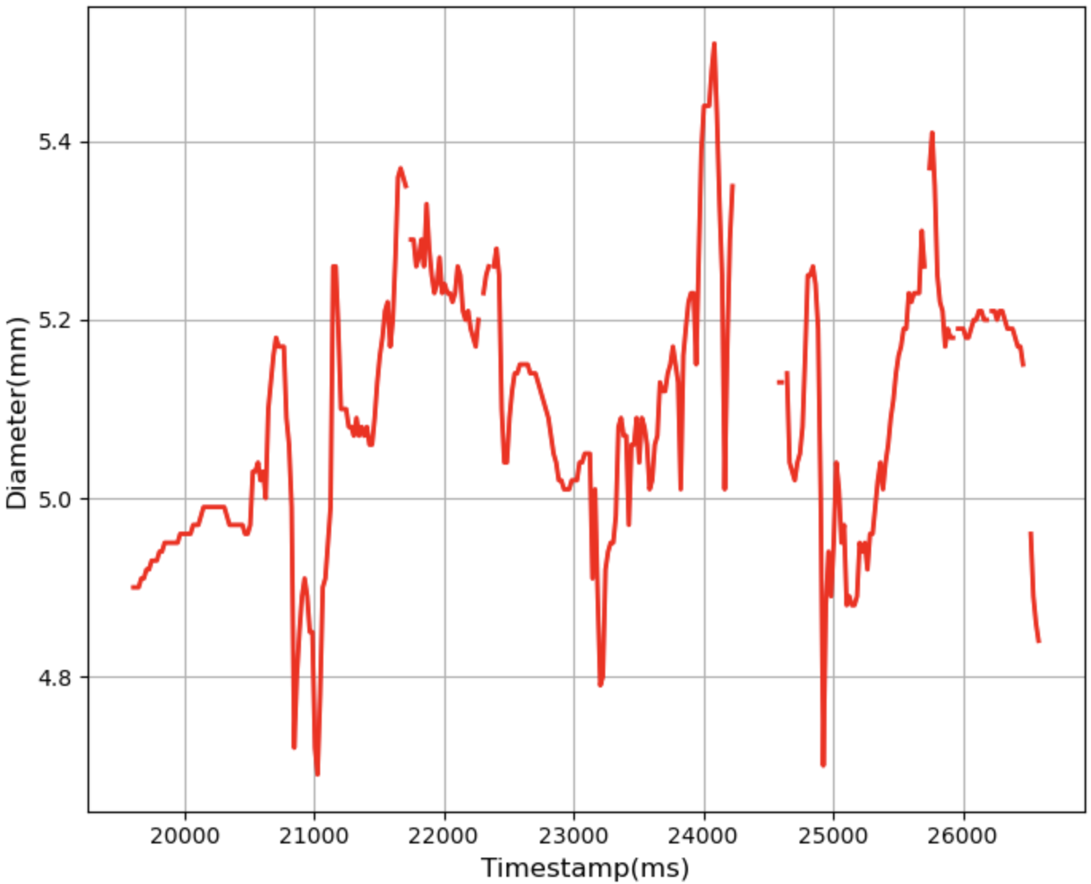
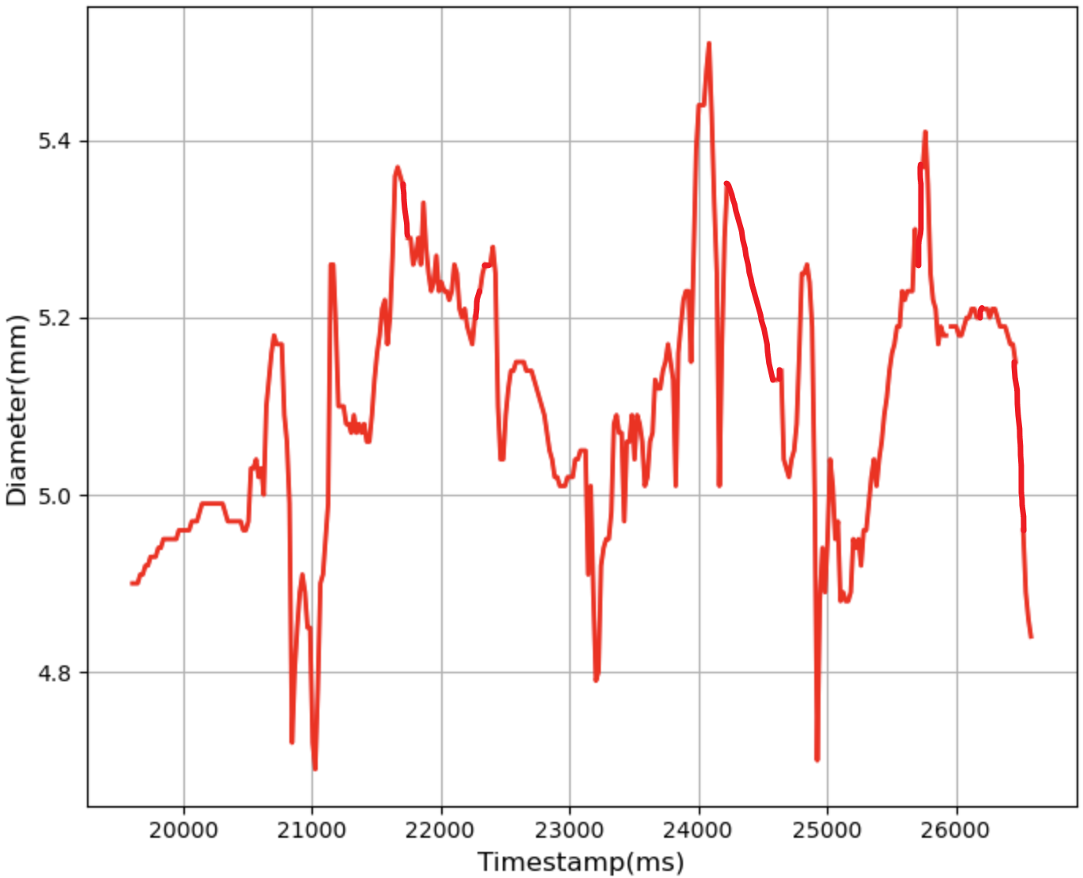
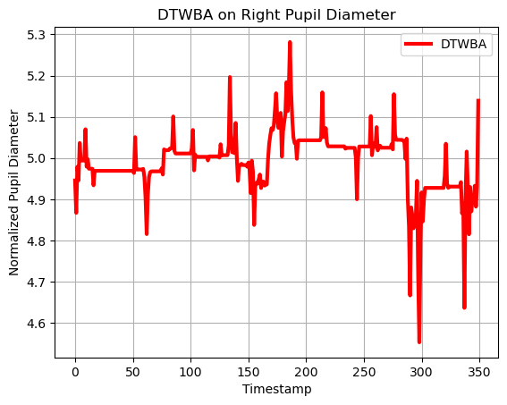
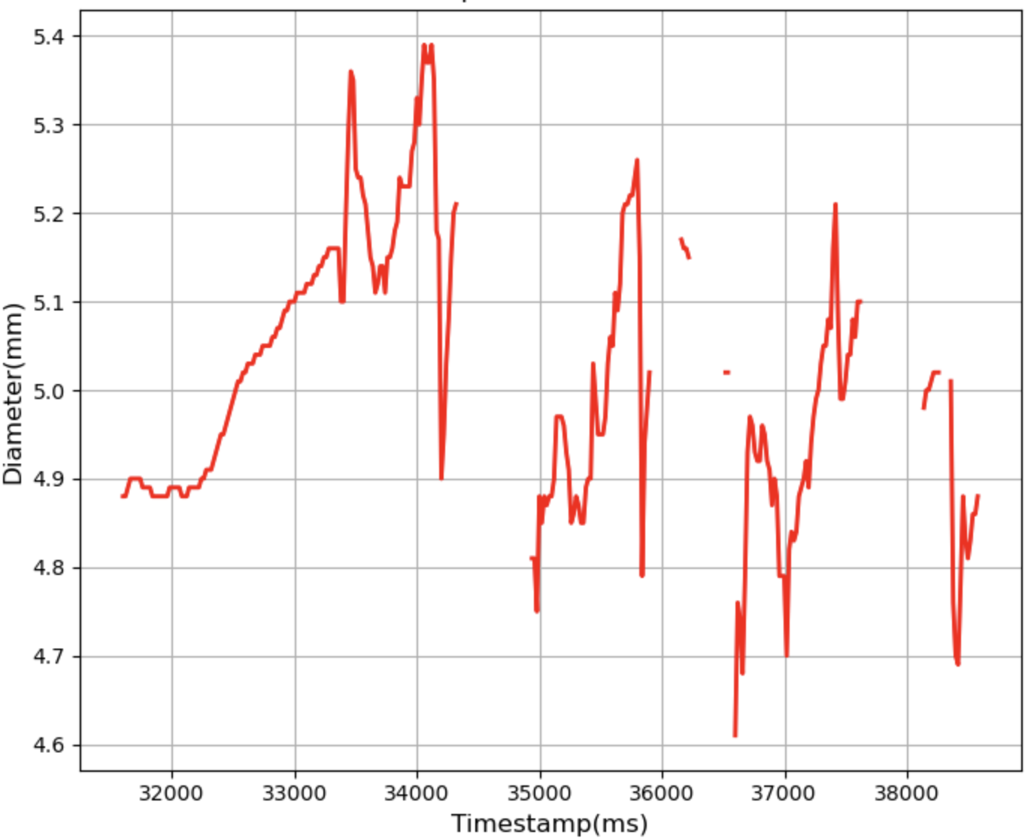
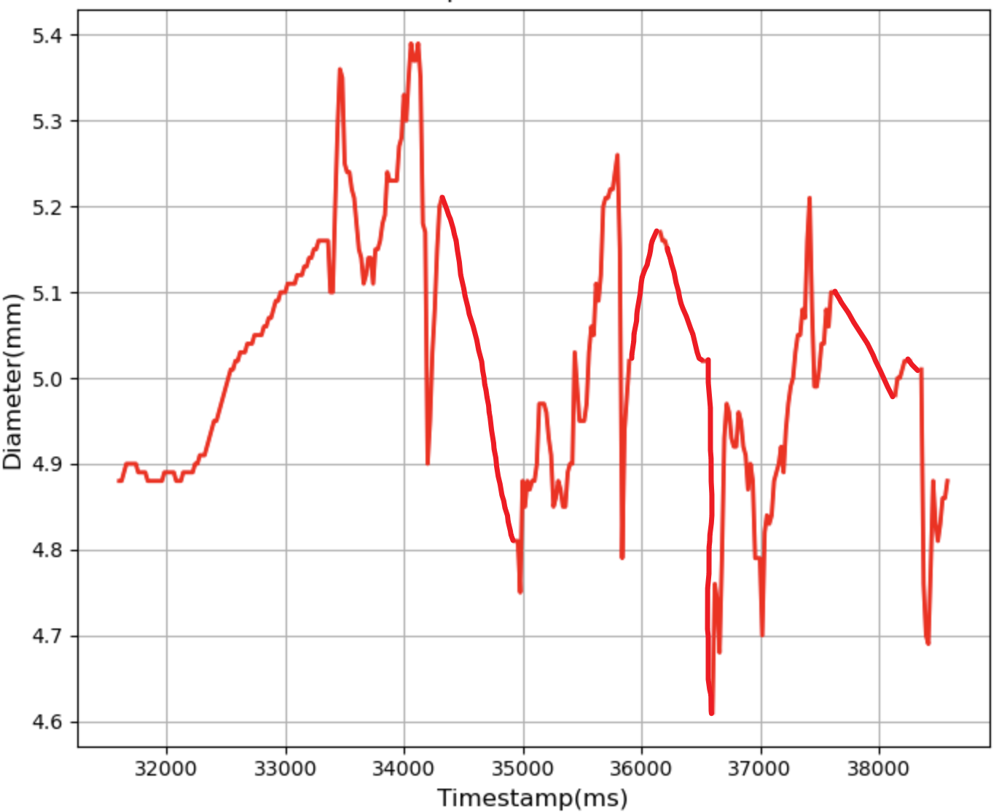
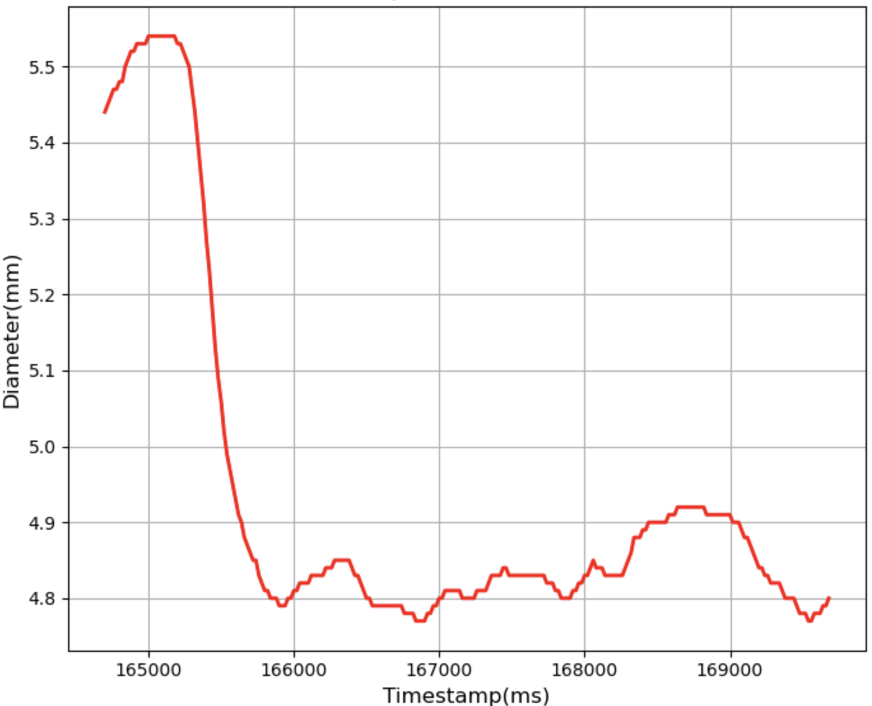
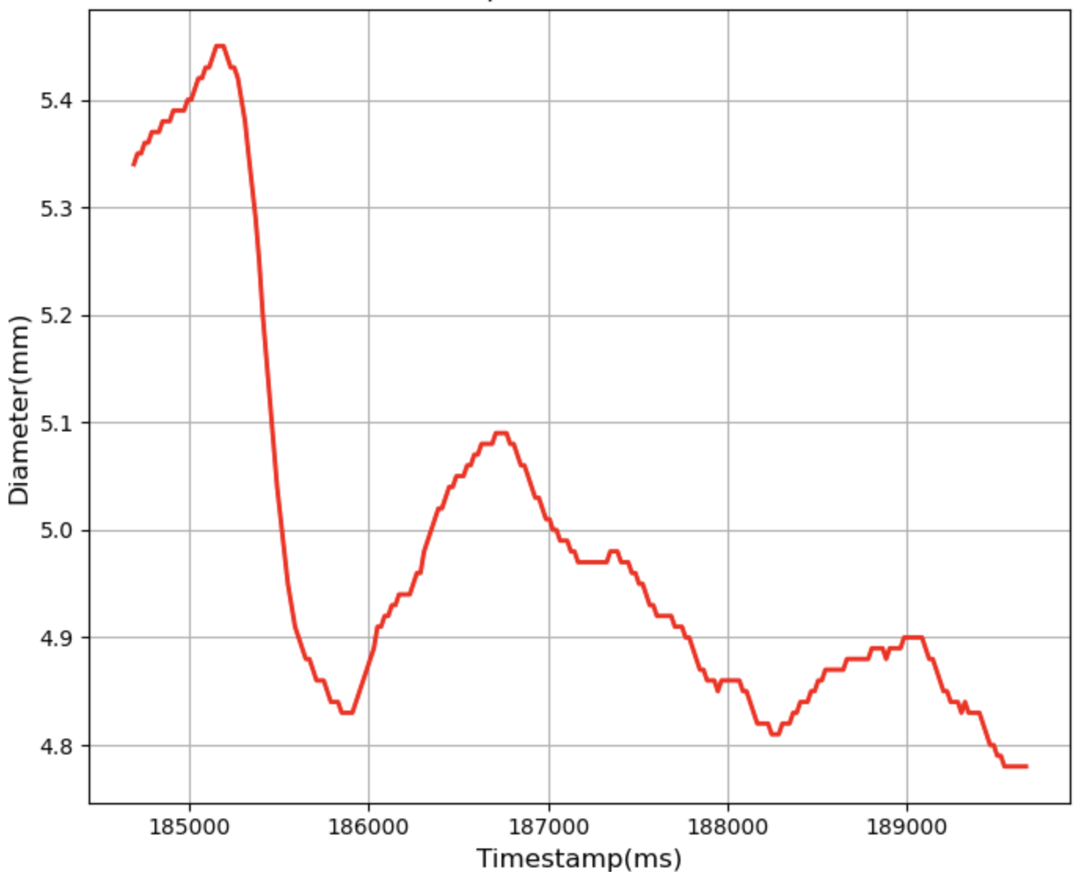
Proposed Method
Process
4
Visual stimuli presentation.
Pupil-size data collection.
DBA generation.
DTW Distances computation.
Threshold determination.
EER Evaluation.
Data Collection
DBA Generation
… …
Threshold Determination
DTW Computation
0.89
1.03
1.21
1.26
…
2.14
2.20
2.45
2.56
…
… …
… …
Figure 1. Method Process
Notes:
To achieve that,
When participants
Next, … , which I’ll talk about later
Then,
These DTW distances allow us to determine … , … turn out whether or no … is feasible
… used EER as our evaluation metrics…in our experiment

Slide 5
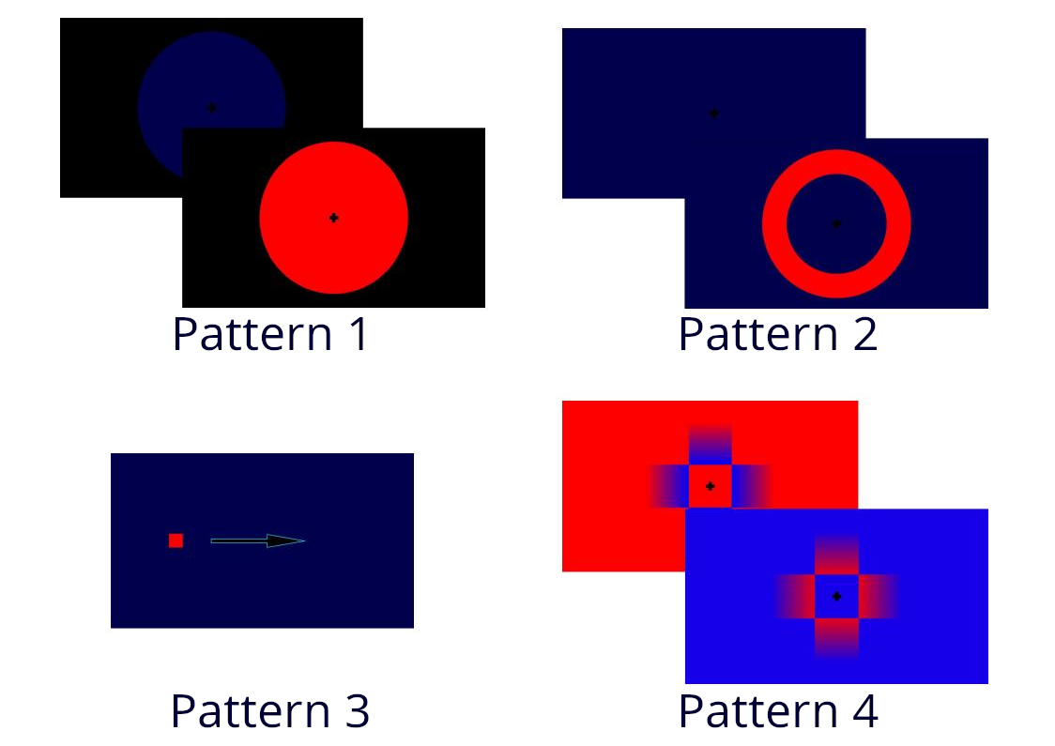
Proposed Method
Stimulus Design
5
Four Color Combinations
Red-blue, Yellow-blue, Red-green, and Green-blue
Four Stimulus Patterns
Two solid-color circles flicker.
One hollow-circle flicker.
Moving shapes.
Color gradients.
Figure 2. Stimulus Patterns
Notes:
Before we go into the process,
So we’ve designed…
The first stimulus pattern is
…of color gradients
Totally, we’ve designed …in our experiment

Slide 6
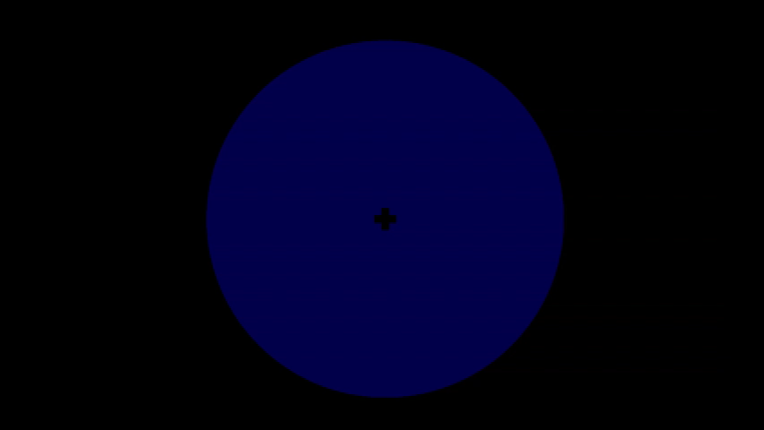
Proposed Method
Stimulus Design——Pattern 1
6
Video 1. Stimulus Pattern 1
Notes:
Before we go into the process,
So we’ve designed…
The first stimulus pattern is
…of color gradients
Totally, we’ve designed …in our experiment

Slide 7
Proposed Method
Stimulus Design
7
Four Color Combinations
Red-blue, Yellow-blue, Red-green, and Green-blue
Four Stimulus Patterns
Two solid-color circles flicker.
One hollow-circle flicker.
Moving shapes.
Color gradients.
Figure 2. Stimulus Patterns
Notes:
Before we go into the process,
So we’ve designed…
The first stimulus pattern is
…of color gradients
Totally, we’ve designed …in our experiment

Slide 8
Proposed Method
Data Collection
8
A well-lit room
6 male participants
Visual stimuli were presented on a 24-inch display.
Sat 60 cm away from the display.
Tobii Pro Glasses 2 Eye Tracker.
Each stimulus was repeated 10 times.
Data Collection
Figure 3. Data Collection
Notes:
This figure
…conducted

Slide 9
Proposed Method
DBA Generation
9
DBA Definition
The average of multiple time series sequences.
DBA Generation
First, the collected data were linearly interpolated.
Second, the subject-specific DBA template was generated.
DBA Generation
Origin Interpolated DBA
… …
Figure 4. DBA Generation
Notes:
The collected data are…
Normally, the collected pupil size data are stored as the form of …
Although we’ve collected 10 … for each participant, …they vary in different wavelength
In order to find out a time series sequence that …
We applied the DBA in our proposed method, which …, to get the representative
… to reduce the influence of blinking
… tslearn

Slide 10
Proposed Method
DTW Computation
10
DTW Distance
The distance between two time series sequences.
Pairwise Comparison
DTW computation between the DBA template and the subject.
DTW computation between the DBA template and each other participant.
DTW Computation
DBA Comparison
with the Subject
DBA Comparison
with Another Participant
0.89
1.03
1.21
1.26
…
2.14
2.20
2.45
2.56
…
… …
… …
Figure 5. DTW Computation
Notes:
…
The DTW distances measure …
By computing this , we could find out each pupil size data … either … or …
We computed …
For each pairwise … , we could get 20 constant numbers, leading us to …

Slide 11
Proposed Method
Threshold Determination
11
The threshold was used to distinguish the subject’s data from those of other participants.
Evaluation Metrics
FRR (False Rejection Rate)
FAR (False Acceptance Rate)
EER (Equal Error Rate)
Threshold Determination
Threshold(EER=0)
The subject
1
2
3
Another Participant
Figure 6. Threshold Determination
Notes:
Looking at figure 6, if our … was true, we could find a threshold, where the DTW distances compared with …
This is how we distinguish the target subject from others.
(Pause for a second)

Slide 12
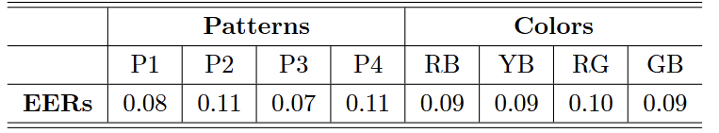
Experiment Result
12
General Result:
All EERs range from 0.07 to 0.11.
This result indicates pupil size changes has potential for personal authentication.
Further Analysis:
Pattern 1 (0.08) and Pattern 3 (0.07) exhibit better EERs than Pattern 2 and 4 (both 0.11).
Color combinations show no significant effect on eliciting pupil size features.
Table 2. Experiment Result
Notes:
P1-P4: Pattern 1 to Pattern 4.
RB, YB, RG, and GB: Red-Blue, Yellow-Blue, Red-Green, and Green-Blue
…
We confess this result is not small enough, but still … feasibility for …
…,
This result shows a …
…

Slide 13
Conclusion
13
Conclusion:
This study evaluated a personal authentication approach based on pupil size changes.
The EERs ranged from 0.07 to 0.11, indicating the feasibility for personal authentication.
Future studies:
Implementation of the proposed method in a real VR-device environment.
Investigation of the mechanism that explains why certain visual stimuli outperformed other on eliciting pupil size features.
Notes:
…
In the meantime
This conclude my presentation

